Slide 1
Wireless Channel and Diversity
Introduction
Fading
Types of fading
Diversity
Types of Diversity
By Jasleen Kaur
IT dept.
GTBIT

Slide 2
Wireless Communication is prone to noise, interference and other channel obstruction which change over time unpredictably resulting degradation of signal. Losses in signal arises both in transmission of signal in short distances well as long distance.
Two types of communication channels:
Wired channels
Radio or wireless channels.
The wired channels are stationary and predictable whereas the radio channels are extremely random and do not offer easy analysis. Even the speed of motion affects how rapidly the signal level fades as a mobile terminal moves in space.

Slide 3
The signal can be either reflected, diffracted or scattered by obstacles (i.e. buildings, vehicles, trees, mountains etc.) so that multiple copies through multiple paths of the signal with varying delays can be received is known as multipath propagation. The three basic propagation mechanism (i.e. reflection, diffraction & scattering) mainly responsible for multipath propagation.
Multipath propagation mainly produce three effects in wireless communication:
Multipath copies of signal may arrive at different phases.
Multipath propagation produce Inter Symbol Interference(ISI).
Multipath propagation produce short term or small scale fading.

Slide 4
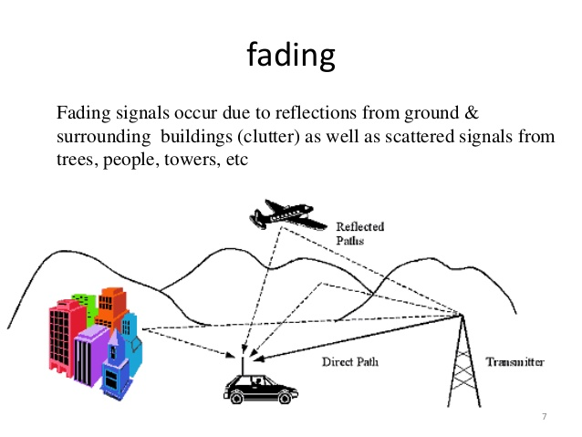
Fading: The strength(power) of received signal varies with respect to time is known as fading.
The main causes of fading are attenuation (loss of signal strength),changes in transmission medium, refraction , multipath propagation, rainfall, obstacles etc.
Fading can be divided into two times:
Large Scale (long term) fading
Small Scale (short term) fading

Slide 5
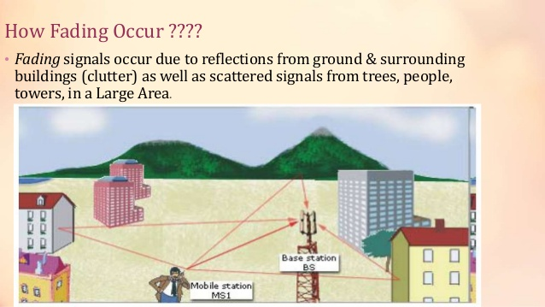

Slide 6
Fading is the most important thing when you design any RF(radio frequency) Design.
The communication between the base station and mobile station in mobile system is mostly non-LOS (line of sight)
The LOS path between transmitter and the receiver is affected by terrain(natural terrain; mountains) and obstructed by buildings and other objects.
The mobile station is also moving in different direction at different speed.
The RF signal from the transmitter is scattered by reflection and diffraction and reaches the receiver through many non-LOS paths.
This non-LOS path causes long term and short term fluctuation in the form of log normal fading and rayleigh and rician fading, which degrades the performance of RF channel.

Slide 7
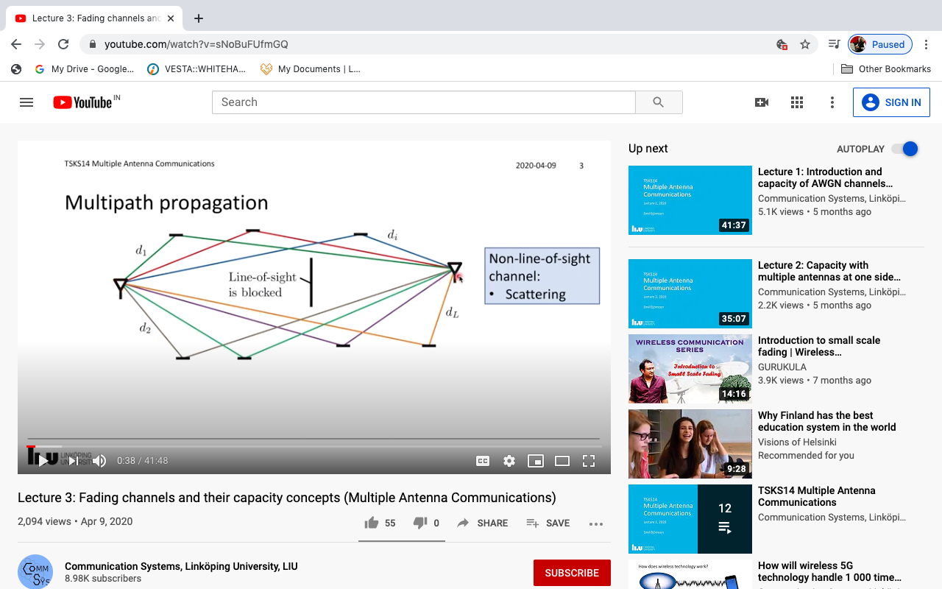

Slide 8
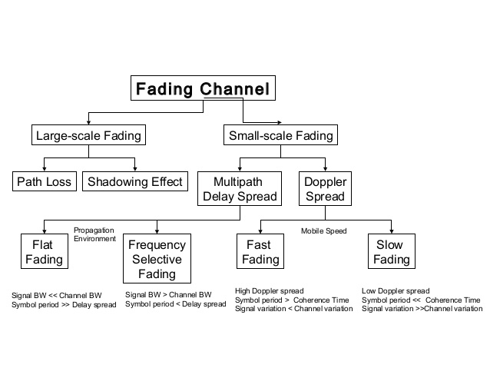

Slide 9
Large Scale Fading:
The local mean (average) power over time duration is known as long term fading. Fading duration is very long as well as signal attenuation(effect) is large due to path loss and shadowing.
Long term fading is sometimes called ‘shadowing’. It changes over relatively long periods often due to more distant objects.
Large scale fading occurs when an obstacle gets positioned between the wireless device and the signal transmitter. The interference causes significant reduction in signal strength because the wave is shadowed or blocked by the obstacles.
Path Loss : Degradation of signal due to dissipation in path because of propagation effects.
Shadowing: Caused by obstacles that absorbs power.

Slide 10
2) Small Scale Fading:
This refers to the fluctuations in signal strength and phase over short distance and small duration of time. It is also called Rayleigh Fading. Small Scale Fading affects almost all forms of wireless communication and overcoming them is a necessity to increase efficiency and decrease error.
Reasons of small scale fading:
Rapid change in signal strength over small distance.
Time dispersion due to multipath delays.
Here loss is caused due to multipath delays and Doppler’s spreading.
When mobile it is worse as the multi-path effects are continuously changing. Also get Doppler effects – the frequency changes due to movement of objects in the environment including the user.

Slide 11
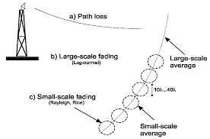
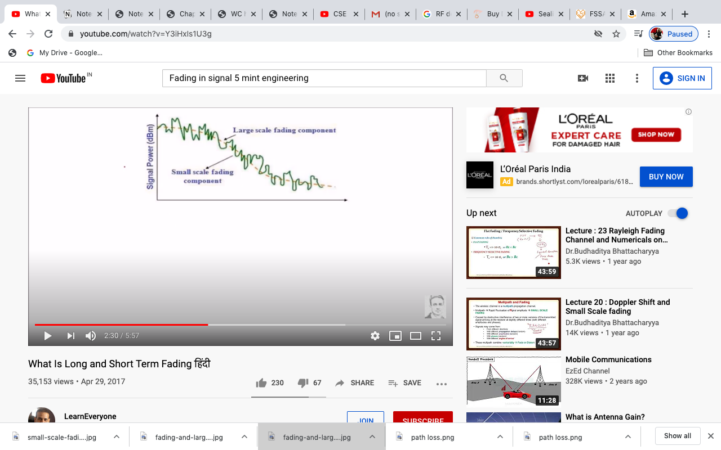
Multipath Propagation: Addition of constructive and deconstructive signal components while propagating.
Doppler’s spreading: Change in frequency due to relative motion of RX with respect to TX.

Slide 12
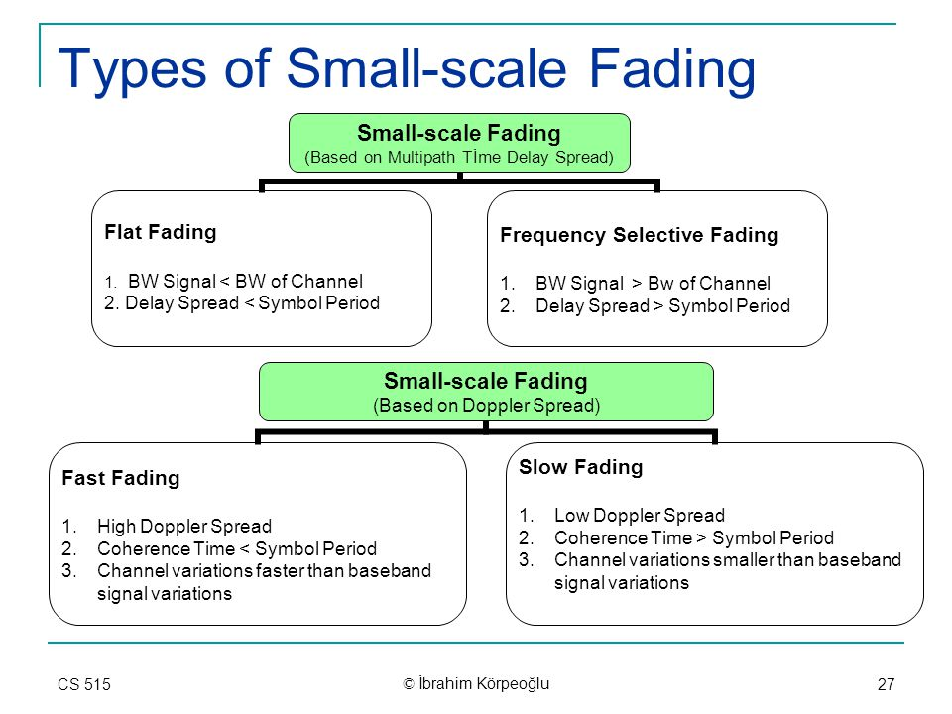
Types of fading experienced by Tx signal depends on the nature of Tx signal with respect to characteristics of channel.

Slide 13
Based on Doppler Spread:
1. Fast Fading Channel:
High doppler spread is observed in the fast fading with Doppler bandwidth comparable to or greater than the bandwidth of the signal and the channel variations are as fast or faster than the signal variations
It is caused due to frequency dispersion due to Doppler’s spreading.
In Fast fading, the rate of change of channel is faster than rate of change of Tx signal.
Tc < Ts (Coherence time is less than symbol time)
Doppler spread is greater than Transmitted (Tx) signal Bandwidth.
Bsignal < Bdoppler spread.

Slide 14
2. Slow Fading:
Low Doppler spread is observed in Slow Fading with the Doppler bandwidth being smaller compared to the bandwidth of the signal and the channel variations are slow relative to the signal variations.
It is caused due to frequency dispersion due to Doppler spreading.
In slow fading, the rate of change of channel is slower than rate of change of TX signal.
Ts<<Tc
Doppler Spread is smaller than transmitted signal (Tx) bandwidth
Bsignal>>Bdoppler

Slide 15
Based on Multipath Propagation:
Flat Fading:
In flat fading, all frequency components get affected almost equally. Flat multipath fading causes the amplitude to fluctuate over a period of time.
It is caused by time dispersion due to multipath components.
Occurs in rx signal if channel has constant gain and linear phase response over Bchannel>Btransmitted signal.

Slide 16
Frequency Selective Fading:
FSF refers to multipath fading when the selected frequency component of the signal is affected.
It means selected frequencies will have increased error and attenuation as compared to other frequency components of the same signal.
Caused due to time dispersion due to delayed multipath components.
Occurs in rx signal if channel has constant gain and linear phased response over Bchannel<Bsignal

Slide 17
Rayleigh & Rician Fading Channels: These fadings occur to a signal as a result of effect of propagation channel.
Rayleigh Fading Channel:
The phenomenon is due to multipath propagation of the signal.
All the signals are NLOS signals and there is no dominant direct path.
Signals from all the paths have comparable signal strengths.
The instantaneous received power seen by a moving antenna becomes a random variable depending on the location of the antenna.
It is assumed that variation in signal passed through Rayleigh fading channel would follow Rayleigh distribution.

Slide 18
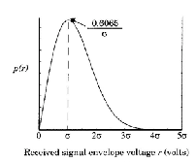
vi. Signal passing through this channel follows Rayleigh distribution.
vii. It is caused due to reflected and scattered waves.
viii. When there is no LOS (line of sight) path available between transmitter and receiver, received signal obey Rayleigh Distribution. It is assumed that the magnitude of a signal that has passed through a Tx (transmitter medium) will vary randomly or fade according to Rayleigh Distribution.
Graphical representation of Rayleigh Probability Density function (P.D.F). :

Slide 19
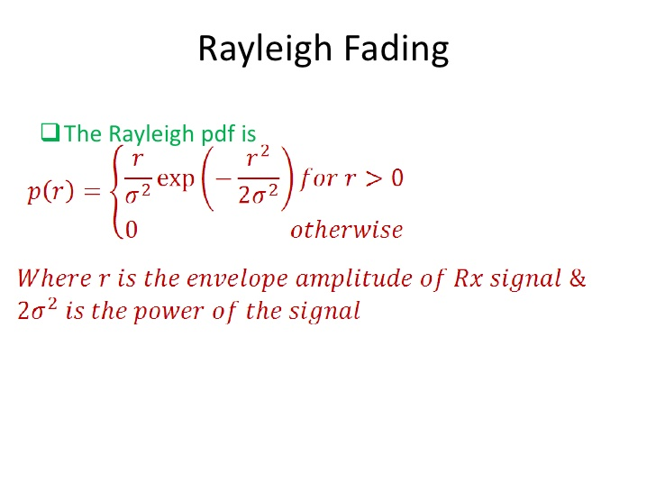

Slide 20
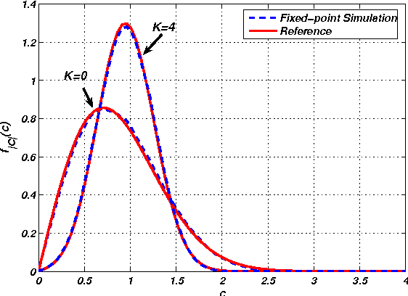
Rician Fading Channel:
This phenomenon is due to multipath propagation of the signal.
In this case there is partially scattered field.
One dominant signal, others are weaker.
When direct LOS path is available between transmitter and receiver, the received signal obey Rician Distribution.

Slide 21
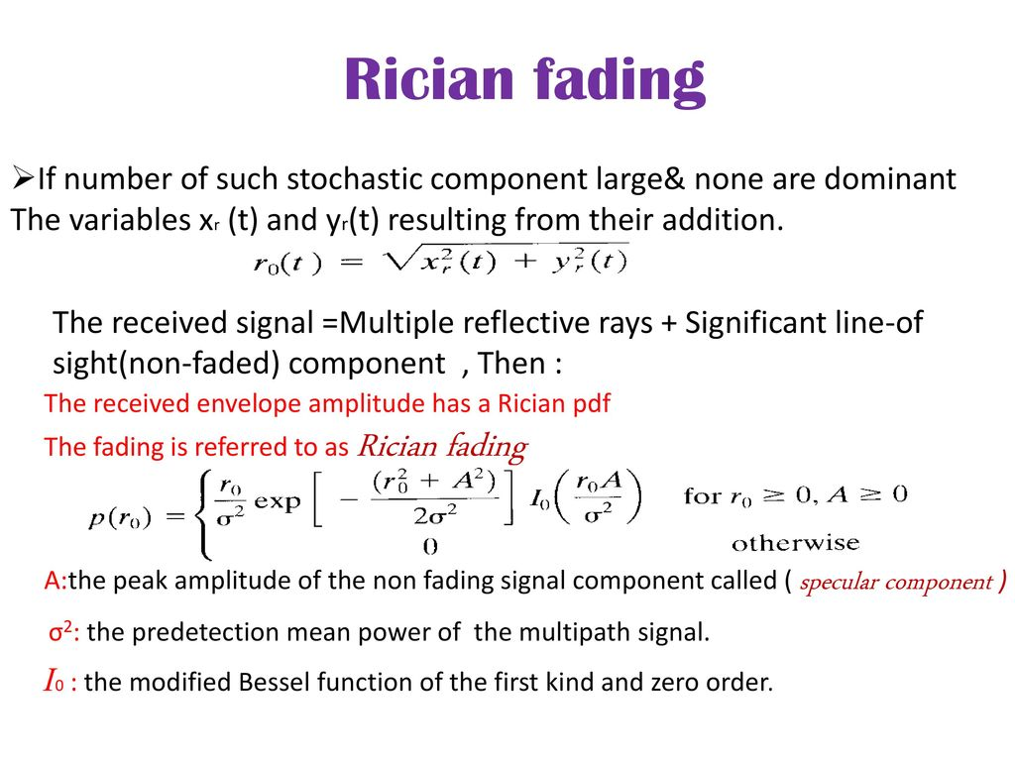

Slide 22
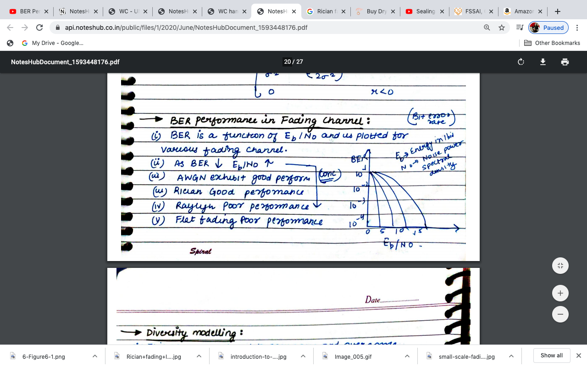
BER performance in fading Channels:
BER stands for Bit Error Rate per bit transferred.
BER is a function of Eb/No and is plotted for various fading channel.
Eb is average energy per bit, No is noise power density.
As BER decreases ,Eb/No increases

Slide 23
Conclusion:
AWGN exhibit good performance. (Additive White Gaussian Noise channel)
Rician fading good performance.
Rayleigh fading bad performance.
Flat fading poor performance.

Slide 24
Diversity Modeling
This was introduced to compare and overcome deep fading.
As in deep fading if we have single channel the connection will get interrupted or link will failed due to fading. Hence, to remove this problem.
Multiple links are applied between transmitter and receiver which not affect communication even after fading.
Diversity is divided into two parts:
Microscopic Diversity
Macroscopic Diversity

Slide 25
Microscopic:
Small signal fading can be minimized by this technique.
It can prevent small scale fading by using two antennas separated by small distance.
By selecting strong signal at all time a receiver can mitigate small scale fading.
Macroscopic:
In large scale fading , the signal strength reduces because of shadowing process.
In this Base station separated by long distance by choosing Base station that is not shadowed (less deep fade) when compare to others the mobile unit can acquire a better signal to noise ratio in its forward path. Such contacting reduces large scale fading.

Slide 26
Types of Diversity:
Space Diversity Technique
Polarization Diversity
Frequency diversity
Time Diversity

Slide 27
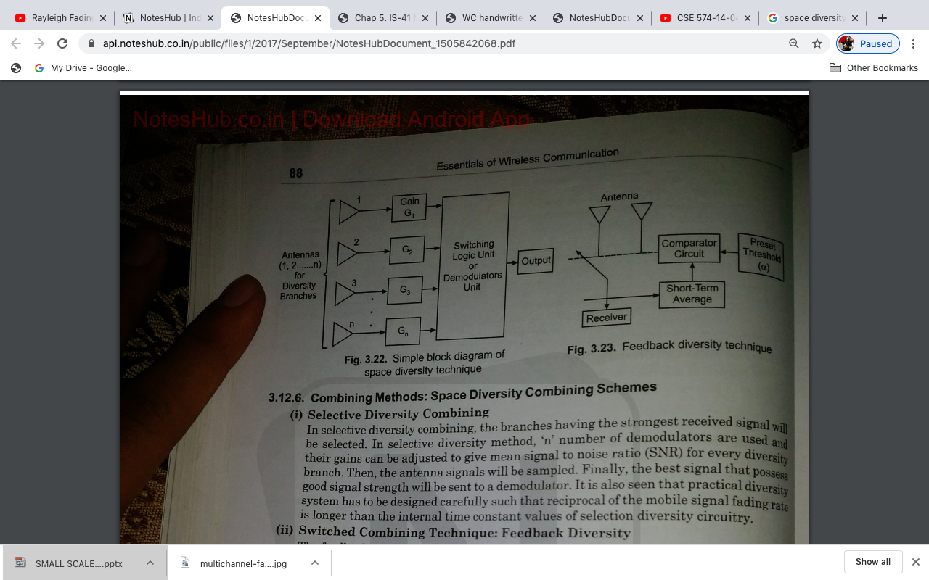
Space Diversity: This is most conventional method in which we have several antennas which are separated by different frequency band and they reach to receiver. Even if one got defade rest will reach to receiver. There are 4 types of subdivision:
Selection Diversity
Feedback Diversity
Maximal Diversity
Equal Gain Diversity

Slide 28
2. Polarization Diversity: This is used where signal is transmitted using pair of polarized antenna and receiver by another pair of antennas then fading channel can be receiver. Hence this diversity is used. Circular and linear antenna are used.
3. Frequency Diversity: In this information is transferred/carried by many carrier frequency. Info is sent on carrier from transmitter end to receiver end.
4. Time Frequency: In time diversity information is transmitted repeatedly after a specific time. It leads to repetition of signal also.

